Slide 1
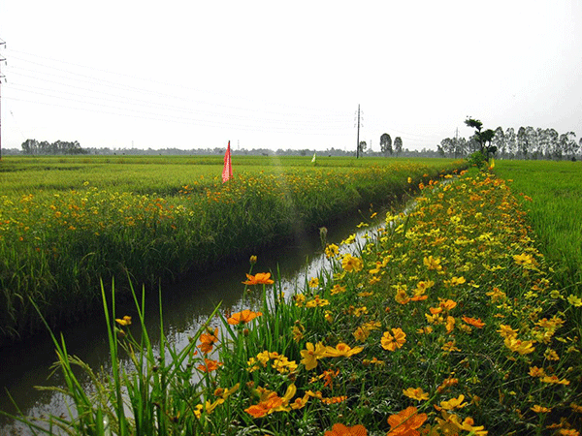
INNOVATIVE EXTENSION-ECOLOGICAL ENGINEERING PRACTICES

Slide 2
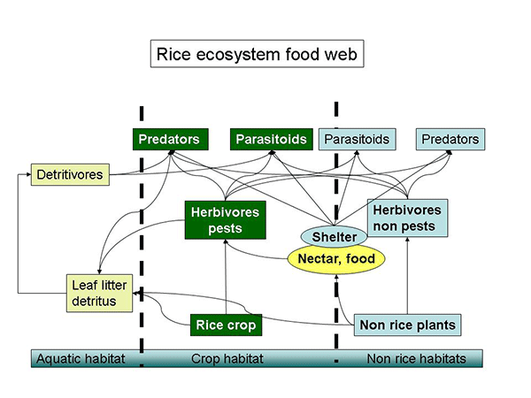
ECOLOGICAL ENGINEERING PRACTICES IN PADDY

Slide 3
Wet land ecosystem | Garden land ecosystem
Sufficient number of parasites predators and micro organisms established well in advance | These organisms develop only after pest established
Pest are received by NE’s | Pests are directly attacking the crop
Foliage loss of rice upto 50% till 45 DAT will not reduce yield. | Foliage loss directly affect yield.

Slide 4
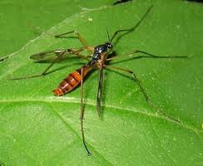
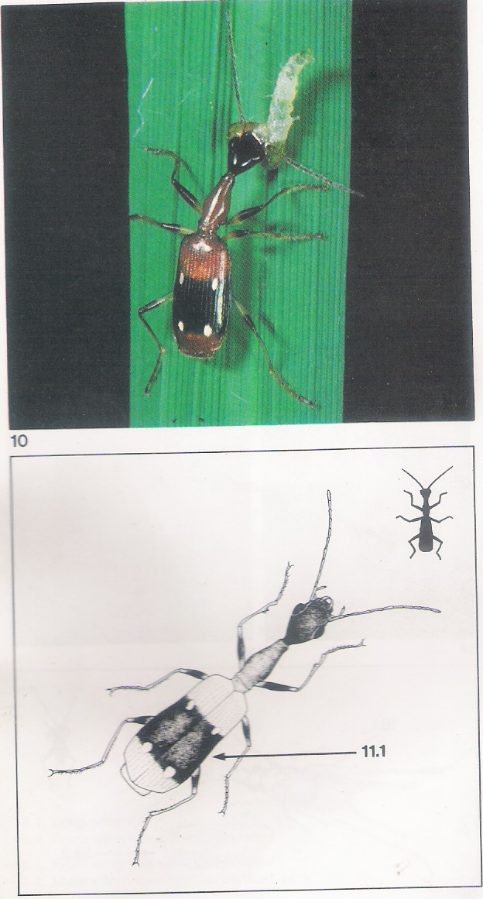
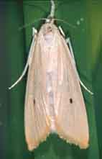
RICE ECOSYSTEM FOOD WEB
3 Types of insects in paddy fields
Neutrals in in paddy fields
Natural enemies in paddy fields
Insect pests in paddy fields

Slide 5
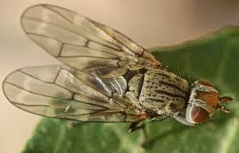
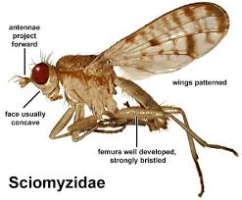
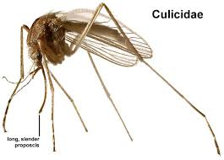
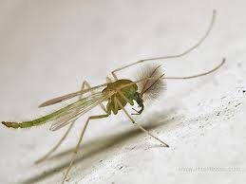
NEUTRALS IN PADDY FIELDS
Filter feeders – feeds on small plants
Detritivors – feeds on small animals
Otitidae
Chironomidae
Tanyderidae

Slide 6
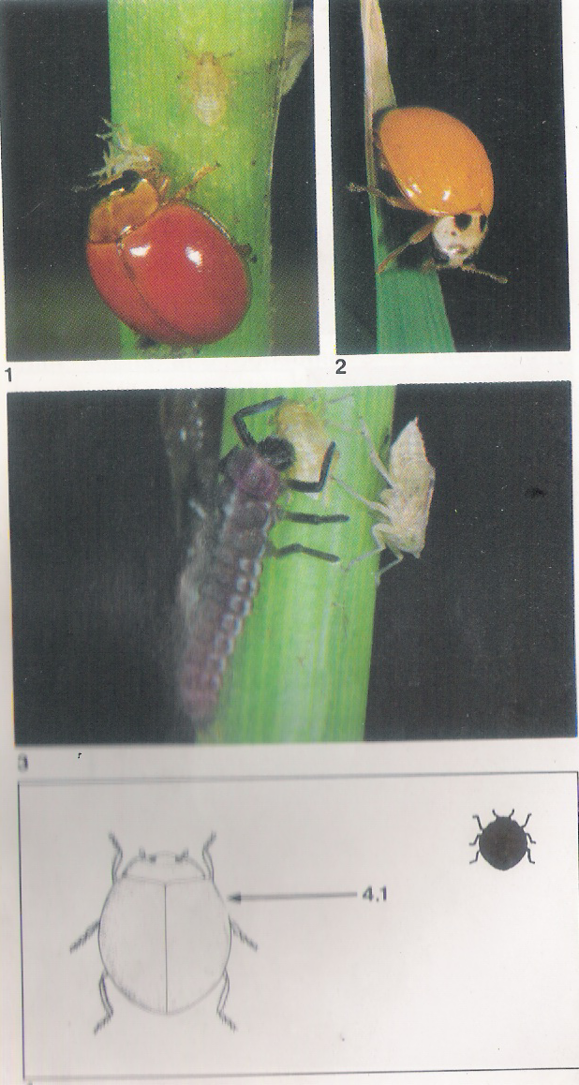
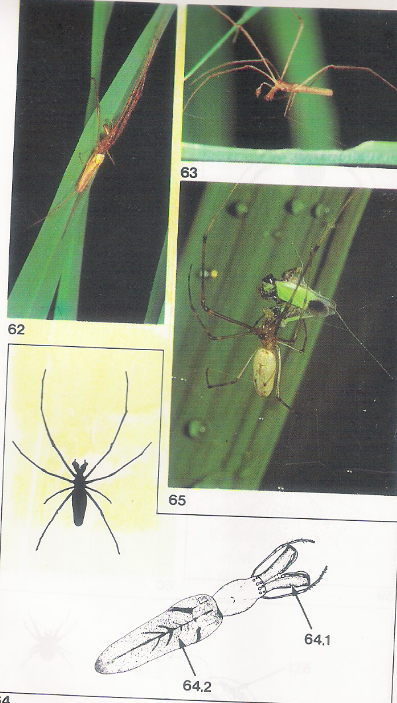
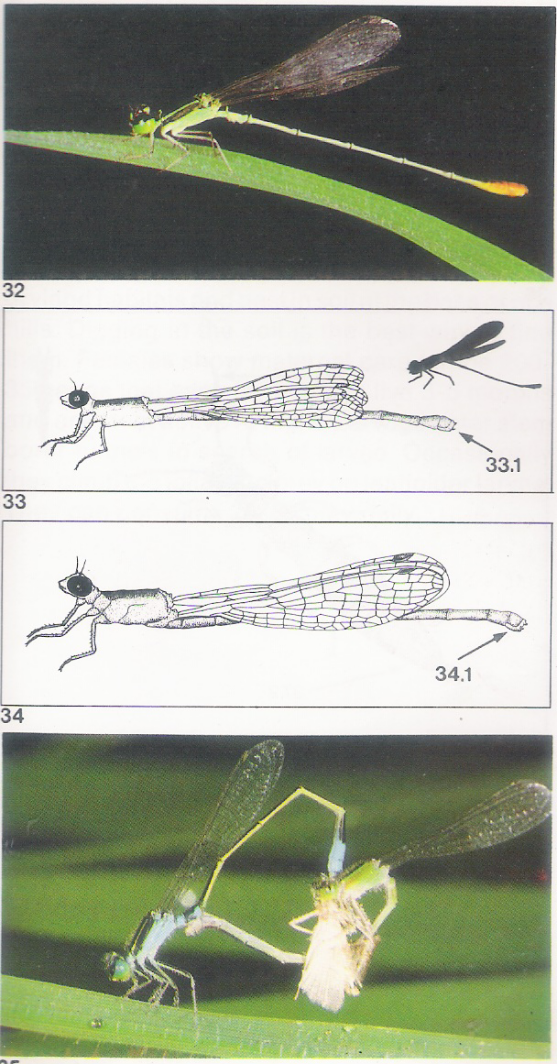
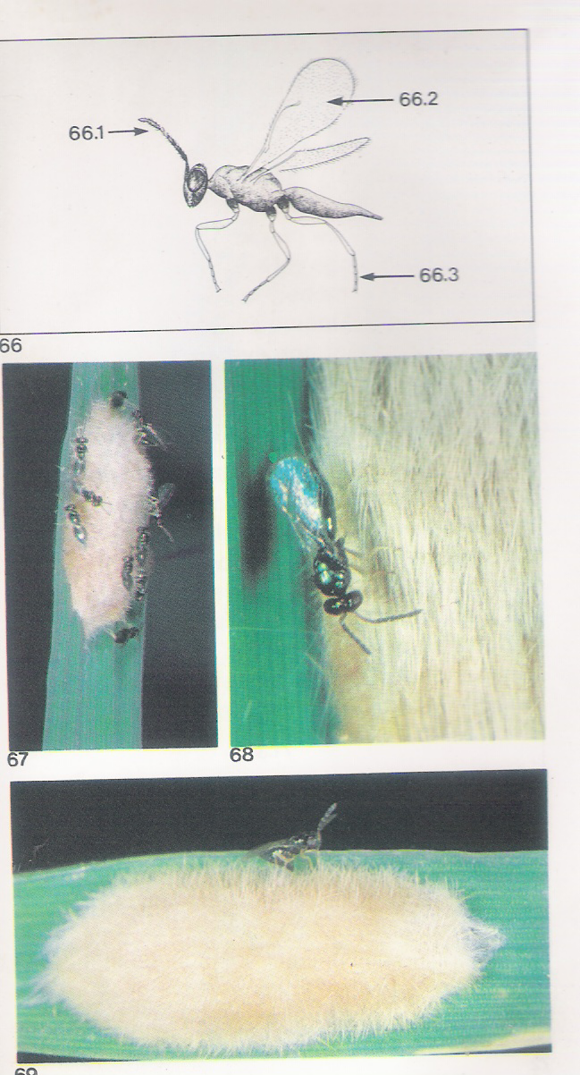
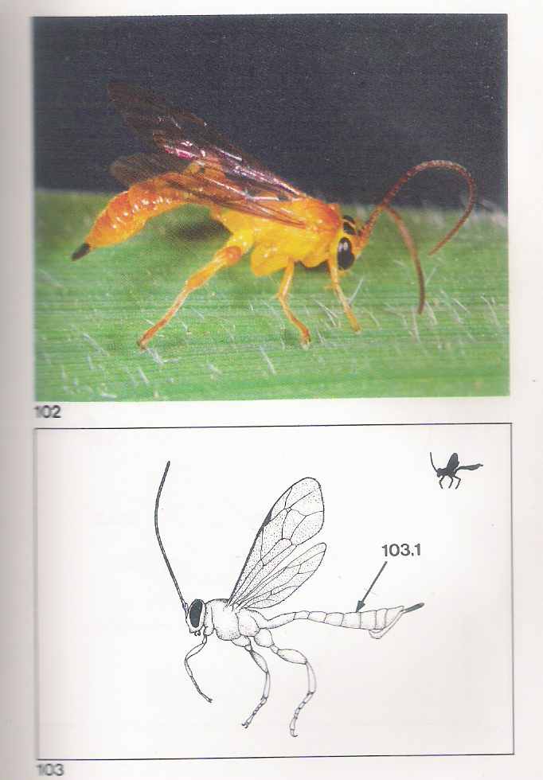
NATURAL ENEMIES IN PADDY FIELDS
Predators
Spiders
Damsel flies
Beetles
Crickets
Grass Hoppers
Bugs
Parasitoides
Egg parasitoides
Larval parasitoides
Pupal Parasitoides
Adult feeders

Slide 7
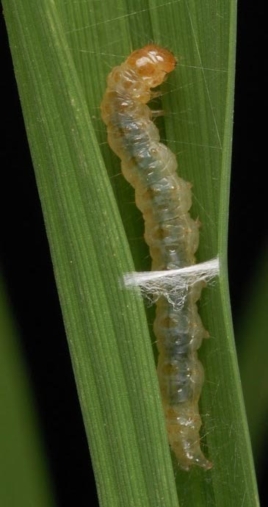
PESTS IN PADDY FIELDS
Leaf folder in Rice
Stem Borer in Rice
Gall midge in Rice
Thrips in Rice
Case worm in Rice
Blue beetle in Rice
Skipper in Rice

Slide 8
PADDY ECOSYSTEM
1st 20 days – More neutrals and natural enemies than pests of paddy
20 days to 45 days – More natural enemies than pests of paddy
45 days to 75 days – more pests than natural enemies
75 days to 90 days – less pests and less natural enemies

Slide 9
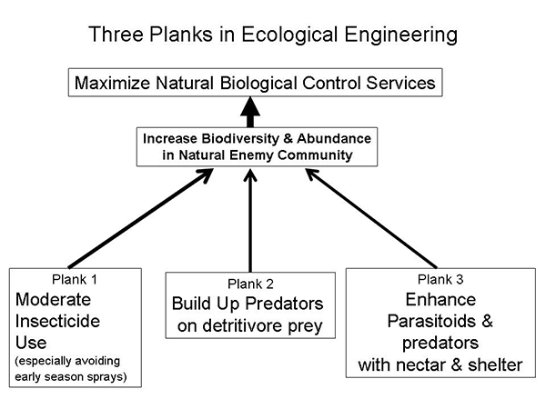
ECOLOGICAL ENGINEERING PRACTICES

Slide 10
Plank 1: Moderated insecticide use – especially early in the season
Early season insecticide applications in the first 40 days after sowing are known to have little or no effects on yields. They are generally applied as a prophylactic or to control leaf folders and pyrethroids and insecticides that have high toxicities to hymenopterans are typically used. Such sprays do more harm than good, by destroying natural enemies and the aquatic detritivore prey fauna. It has been shown that early sprays significantly decrease food chain lengths and disorganize predator-prey relationships (Heong and Schoenly 1998).

Slide 11
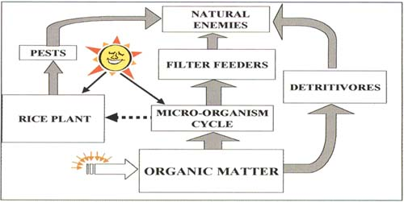
Plank 2: Enhancement of generalist natural enemies – predator build up on detritivore prey

Slide 12
Rice has three separate pathways for energy supporting natural enemies
NATURAL ENEMIES
HERBIVORES
FILTER-FEEDERS
DETRITIVORES
MICRO-ORGANISM CYCLE
RICE PLANT
Sunlight
ORGANIC MATTER

Slide 13
Functional group relationships among the major elements in the rice community
HERBIVORES
HYPER PARASITOIDS
PREDATORS
PARASITOIDS
FILTER-FEEDERS (Adult Chironomidae, Culicidae)
DETRITIVORES (Adult Diptera, Coleoptera)
RICE PLANT
DETRITIVORES (Surface- Dwelling Collembola)
FILTER FEEDERS (Larvae)
AQUATIC PREDATORS
DETRITIVORES (Aquatic Larvae)
ZOOPLANKTON
BACTERIA
ORGANIC RESIDUE

Slide 14
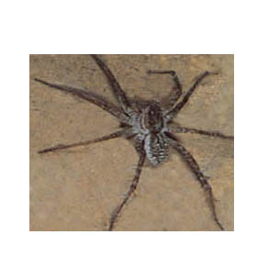
Predators

Slide 15
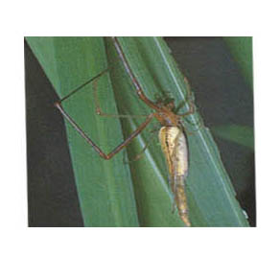

Slide 16
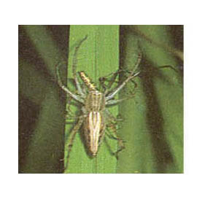

Slide 17
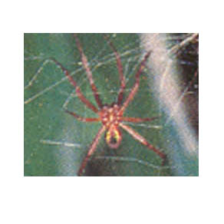

Slide 18
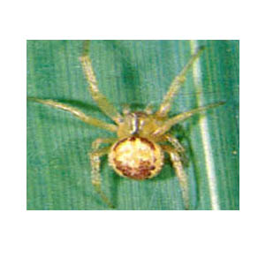

Slide 19
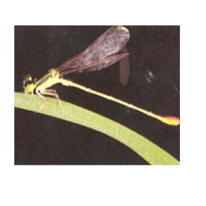

Slide 20
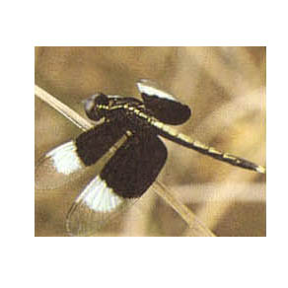

Slide 21
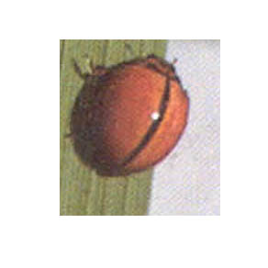

Slide 22
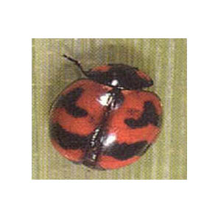

Slide 23
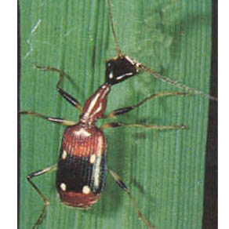

Slide 24
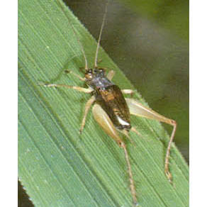

Slide 25
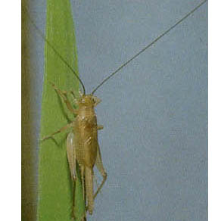

Slide 26
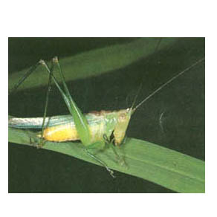

Slide 27
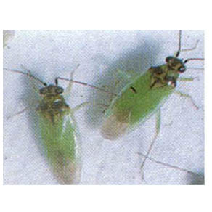

Slide 28
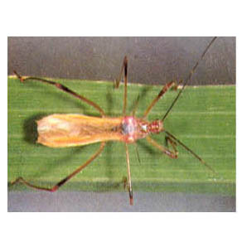

Slide 29
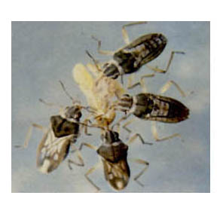

Slide 30
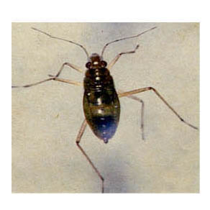

Slide 31
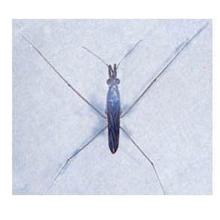

Slide 32
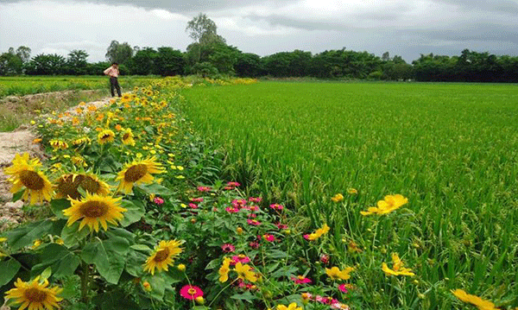
Plank 3: Enhancement of specialist natural enemies by habitat manipulation – nectar plants on bunds

Slide 33
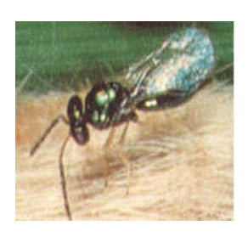
Parasites

Slide 34
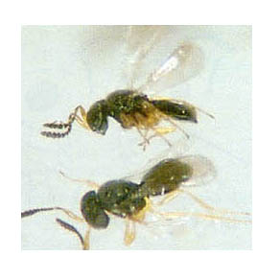

Slide 35
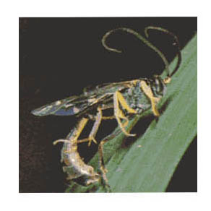

Slide 36
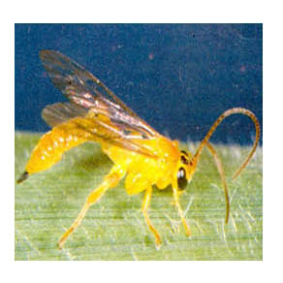

Slide 37
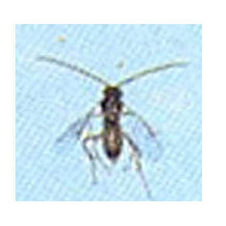

Slide 38
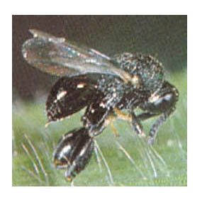

Slide 39
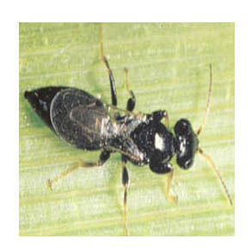

Slide 40
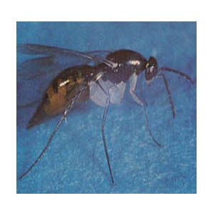

Slide 41
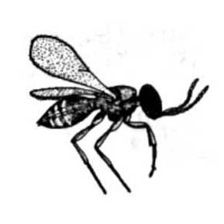

Slide 42
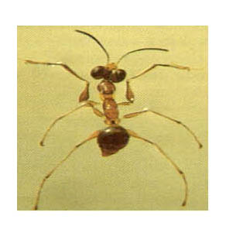

Slide 43
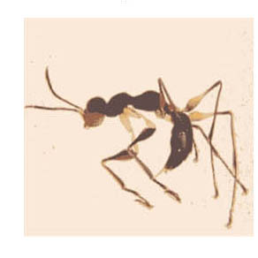

Slide 44
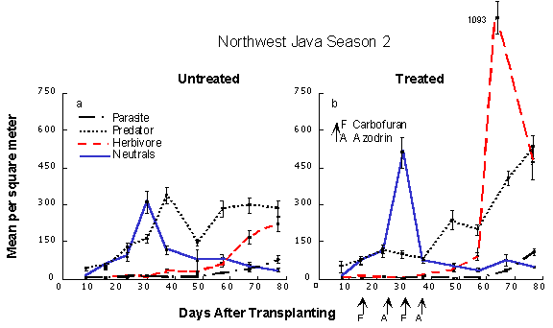
Predator gets an opportunity to develop well in advance of normal pest population
Treated and un treated

Slide 45
Treated with pesticides and untreated
Untreated-Rise in neutral peak at 30 days. Subsequent rise of predator populations.Predator population build up on neutrals.pest populations have little chance to develop late in the season.
Treated-Leads to suppression of early season predator populations. subsequent resurgence of pest populations-Pesticide induced pest resurgence.

Slide 46
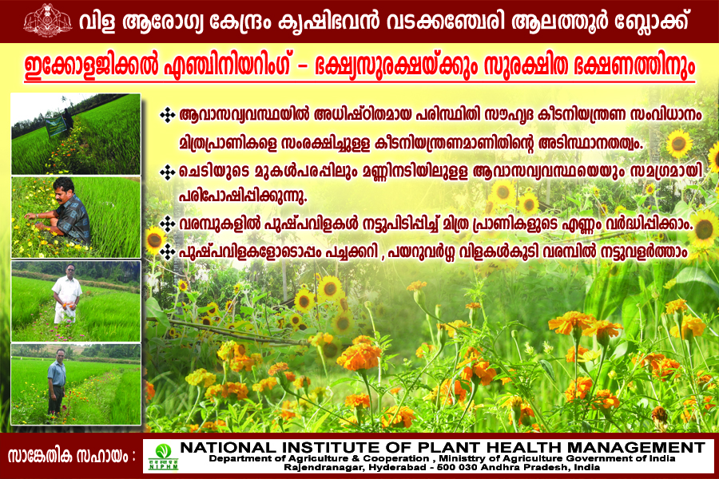

Slide 47
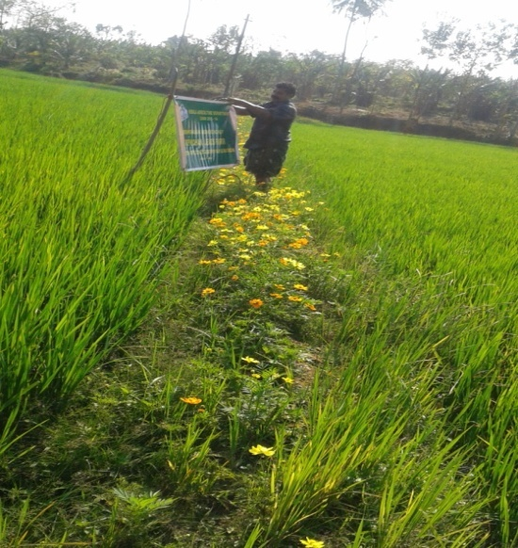

ECOLOGICAL ENGINEERING IN PADDY
Popularised by NIPHM, HYDERABAD
Area: 1 acre, Mechanised planting
Use of VAM, Azospirillum, Pseudomonas
Application of fertilisers based on soil test data
Planting of flowering plants (marrigold
and cosmos, cowpea, Urd dal) on bunds
Conservation of natural enemies, trichocards
Result: Non pesticides management of paddy
Yield: 3450 kg per acre
Cost of cultivation reduced to 30%

Slide 48


Ecological engineering in paddy

Slide 49


Above ground and below ground management of ecosystem

Slide 50

Conservation of natural enemies through ecological engineering

Slide 51

Habitat manipulation for pest management

Slide 52


Microorganisams enriches soil also

Slide 53





Increases biodiversity- Additional income to farmers

Slide 54

ECOLOGICAL ENGINEERING IN VEGETABLES – POPULARISED BY NIPHM, HYDRABAD

Slide 55


ADOPTION OF ECOLOGICAL ENGINEERING TO LARGE AREAS THROUGH AESA BASED FARMERS FIELD SCHOOL
AESA – Help to increase the awareness and understanding of the farmers about their field and cultivation, beyond controlling pests.

Slide 56


Crop is opened work book for weekly field observations, sharing of experiences, discussions, decisions and application of appropriate interventions leads to gain new experiences by farmers.

Slide 57

FFS IN A CROP SEASON
Tillering Panicle
GROWTH STAGES
FFS OFFERS PRACTICAL TRAINING TO FARMERS IN FIELD FOR
14 TO 16 WEEKS. EACH FFS HAS 30 FARMERS
AND A FIELD AREA OF 25 ACRES

Slide 58
FFS Learning Field 2.00 acres
Ecological Engineering practices | Field Validation Trials | Farmers’ Practice

Slide 59
































AESA in Rice
Defenders
Pests

Slide 60


AESA BASED FARMERS FIELD SCHOOL IN PADDY
AESA based Pest surveillance to find out pest defender dynamics

Slide 61


Calculating P: D ratio

Slide 62

Preparation of AESA Chart by farmers

Slide 63
Calculation of P: D Ratio to find out management practices
Growth stage of the crop | P: D Ratio | Condition
Nursery stage | 1:8 | High level of defenders
15 DAT | 1:3 | Defender population was high, but lesser than nursery stage
30 DAT | 1:3 | Defender population was high, but lesser than nursery stage – monitoring traps, trichocards
45 DAT | 2:1 | Pest high compared with defenders – control measures to be taken – Trichocards
60 DAT | 2:1 | Pest high compared with defenders – control measures to be taken – Flame torches, fish aminoacids
75 DAT | 1:2 | Defenders higher than pests- no need to take control measures

Slide 64


AESA CHART PREPARED FOR FARMERS
P: D Ratio: 1:3
P:D Ratio: 1:2

Slide 65




AESA BASED FARMERS FIELD SCHOOL IN PADDY
INSTALATION OF TRICHO CARDS IN PADDY FIELD TO CONTROL LEAF FOLDER AND STEM BORER

Slide 66



Monitoring AND MASS TrapPING for YSB in paddy

Slide 67


AESA BASED FARMERS FIELD SCHOOL IN PADDY
CLASSES ON PEST- DEFENDER DYNAMICS AND PREPARATION OF ORGANIC COMPOUND(FISH AMINO ACID)

Slide 68


FLAME TORCHES PLACED ON BUNDS TO KILL RICE BUGS
Flame torches
Flame torches

Slide 69

Exhibitions on Plant Health Management

Slide 70

FIELD DAY OF FARMER FIELD SCHOOL AT KURUVAI PADASEKHARAM

Slide 71
AESA BASED FARMERS FIELD SCHOOL IN PADDY – TO DEMONSTRATE ECOLOGICAL ENGINEERING
Non pesticide management of paddy in 18 ha in kuruvai padasekharam by 48 farmers
Cost of cultivation reduced to 25% (earlier 4-5 sprays costs around Rs 4000 – 5000/ha)
Yield increased to 30% (4200 t/ha to 5500 t/ha )
Income increased by the value addition of paddy as Safe to Eat Rice.
Additional 3rd crop of Organic vegetable by cluster approach
Still adopting the practices in the 3rd year also.
IMPACTS

Slide 72


In News....

Slide 73
AGRO ECOSYSTEM ANALYSIS
Importance of P:D Ratio
DEFENDERS PESTS
Dragon fly-2 Stemborer- 3
Ophionea- 3 Leaf folder- 4
Spides- 10 Blue beetle- 2
Cyrtorhinus -15 BPH- 6
Total- 30 Total- 15
P: D Ratio- 15/30= 1: 2
(Favourable P: D Ratio: 2:1)

Slide 74
Trophic-level of energy flow
irrigated rice
Notes:
Irrigated rice

Slide 75
Agro ecosystem analysis In Rice (AESA)

Slide 76
Concepts of AESA
No population exists as an isolated entity in a locality
Individuals not only interact among themselves for mating, feeding and other purposes but also interact with individuals of other animal and plant populations.

Slide 77
Community
Individuals in a population feed upon and in turn, are fed upon by individuals of other populations. This interacting ‘web’ of populations in an area is called a community.

Slide 78
Ecosystem
The interacting populations in a community are influenced by the physical environment. These assemblages of elements, communities and physical environments are usually referred to as ecosystem. Examples of natural ecosystems are ponds, lakes, forest etc.

Slide 79
Agro Ecosystem
Any ecosystem largely created and maintained to satisfy a human want or need is called an agro ecosystem (AES). Agro ecosystems are the basic unit of study for pest management. A typical AES is composed of more or less uniform crop plant population, weed communities, animal communities, micro biotic communities and the physical environment in which they interact.

Slide 80
Goal of AESA
The goal of agro ecosystem activity is to analyze the field situation by keen observation, recording and interpretation of the data for immediate pest management activities.

Slide 81
Paradigm shift in IPM
Based on the results of IPM studies carried out in SE Asian Countries a paradigm shift in IPM has been formulated.
A shift from
ET model Behavioral decision model
Crop habitat approach ecosystem approach
Crop loss assessment Pest risk assessment
Integration of tactics Integration of concepts
Technology push Farmers need pull

Slide 82
IPM programme agenda
On data base generation.
Enhancement of natural control mechanisms.
Varietal resistance development
Pest damage yield assessment research
Environment impact research
PM policy research

Slide 83
IPM components must be ecosystem focused
They are environment friendly
Cost effective
Practical
Flexible
Mutually compatible and
Sustainable

Slide 84
Wet land ecosystem | Garden land ecosystem
Sufficient number of parasites predators and micro organisms established well in advance | These organisms develop only after pest established
Pest are received by NE’s | Pests are directly attacking the crop
Foliage loss of rice upto 50% till 45 DAT will not reduce yield. | Foliage loss directly affect yield.

Slide 85
Key Pests of Rice

Slide 86

Stem Borer
Stem borer

Slide 87


Slide 88


Slide 89


Slide 90


Slide 91

Leaf Roller

Slide 92


Slide 93


Slide 94

Rice Bug

Slide 95

Rice Thrips

Slide 96


Slide 97


Slide 98


Slide 99

Gallfly

Slide 100


Slide 101


Slide 102

Case worm

Slide 103


Slide 104

Brown Plant Hopper

Slide 105


Slide 106


Slide 107


Slide 108

Rice Hispa

Slide 109


Slide 110


Slide 111

Green leaf Hopper

Slide 112


Slide 113

Climbing Cut Worm

Slide 114


Slide 115

Black Bug

Slide 116


Slide 117


Slide 118


Slide 119


Slide 120


Slide 121


Slide 122
Prior concepts of trophic (feeding or energy flow) relationships in rice ecosystem
NATURAL ENEMIES
PESTS
RICE PLANT
POTENTIAL PESTS
Pre-IPM
RICE PLANT
Traditional IPM concept

Slide 123
AESA – Help to increase the awareness and understanding of the farmers about their field and cultivation, beyond controlling pests.

Slide 124
Agro ecosystem analysis (AESA)
The trainees are devided in to different groups of five participants each
Collect pest and natural enemies from the field by the trainees using hand nets
Record pests natural enemies, disease symptoms etc from 20 hills of rice plants selected at random
Observe weather condition of the day, general condition of the crop, water level, weed status etc.
Collected specimens are transferred and killed with chloroform
Sort out the specimens into pests and natural enemies and record.

Slide 125
Compilation of data, preparation and presentation of AESA chart
Preparation AESA chart by each group
Draw a rice plant at its present stage as observed in the field on the drawing sheet
List out the pests present in the field on the top left hand side and natural enemies on the right hand side of the drawing sheet
Work out the pest defender ration (P:D) and write in the centre of the drawing sheet
Write details regarding weather condition, general condition of the crop, water level, disease incidence, weed status etc. in the lower corner of the right hand side
Draw recommendations based on the details collected and record in the left hand side of the drawing sheet.
Display the AESA chart and present the details of agro eco system analysis by the leader of each group.
Discuss with the members of other groups and give concrete suggestions on the various activities to be carried out immediately in the field.

Slide 126
In farmer field schools –
Weekly monitoring all the factors governing good growth of the crop and high yield. They may observe weather parameters, general condition of the crop, insect pests, natural enemies, disease incidence, water status, soil conditions and weed status.
Based on the observation they will discuss and finalise recommendations for the coming week.

Slide 127

AGRO ECOSYSTEM ANALYSIS CHART (AESA)
Pests
Stemborer - 7
BPH – 11
Leafroller – 2
Gall fly – 4
Green Jassid – 5
Total - 29
Recommendations
Taking all Parameters into
consideration and decide the
farm operations to be
conducted immediately in the
field and record as
recommendations.
Natural Enemies
Spider - 4
Damselfly - 2
Cyrtorhinus – 2
Lady bird beetle – 2
Total - 10
Weather
General condition of the
crop
Water Status
Disease
Weeds

Slide 128
Prior concepts of trophic (feeding or energy flow) relationships in rice ecosystem
NATURAL ENEMIES
PESTS
RICE PLANT
POTENTIAL PESTS
Pre-IPM
RICE PLANT
Traditional IPM concept

Slide 129
Rice has three separate pathways for energy supporting natural enemies
NATURAL ENEMIES
HERBIVORES
FILTER-FEEDERS
DETRITIVORES
MICRO-ORGANISM CYCLE
RICE PLANT
Sunlight
ORGANIC MATTER

Slide 130
Functional group relationships among the major elements in the rice community
HERBIVORES
HYPER PARASITOIDS
PREDATORS
PARASITOIDS
FILTER-FEEDERS (Adult Chironomidae, Culicidae)
DETRITIVORES (Adult Diptera, Coleoptera)
RICE PLANT
DETRITIVORES (Surface- Dwelling Collembola)
FILTER FEEDERS (Larvae)
AQUATIC PREDATORS
DETRITIVORES (Aquatic Larvae)
ZOOPLANKTON
BACTERIA
ORGANIC RESIDUE

Slide 131
AESA is an approach –
which can gainfully employed by Extension functionaries and farmers to
analyse the field situations with regards to
pests,
defenders,
soil conditions,
plant health, and
the influence of climatic factors and
their relationship for growing healthy crop.

Slide 132
The basic components of AESA are
Built in-compensation abilities of the plants.
Soil conditions.
Climatic factors.
Farmers past experience.
Plants health at different stages.
Pest and defender population dynamics

Slide 133

The Methodology of AESA
Field observation
Chart preparation
Group discussion and Decision making
Presentation

Slide 134
General information
In General information we have to take following data
Weather condition
Soil moisture
Crop appearance.
Weeds intensity

Slide 135
Agronomic information on selected plants
1.
Plant height/number of branches .
2.
Number of leaves/leaflets
3.
Leaf area index
4.
5.
Number of flower
6.
Plant canopy
Number of fruit

Slide 136
Plant Protection data
1.Insect Pests | 1.Eggs. 2.Larva’s/nymphs. 3. Adults.
2. Types of Diseases and intensity | Bacterial Viral Fungal Others
3. Nematodes and symptoms
4. Deficiency symptoms
5. Rodent damage symptoms
6. Beneficial organisms | 1. Parasitoids. 2. Predators. 3. Pathogen 4. Parasites

Slide 137

Agro-ecosystem analysis (AESA)
Process
Step 1:
Field Observation in small groups

Slide 138

Step 2:
Drawing

Slide 139
First draw the plant at the centre on a chart.
Then draw pests on left side and defender on the right side.
Indicate the soil condition, weed population, rodent damage etc.
Give natural colours to all the drawing, for instance, draw healthy plant with green colour, diseased plant/leaves with yellow colour.
While drawing the pests and the defenders on the chart care should be taken to draw them at appropriate part of the plant, where they are seen at the time of observation.

Slide 140
The common name of pest and along with diagram.
The weather factor should be reflected in the chart by drawing the diagram of sun just above the plant if the attribute is sunny.
If cloudy, the clouds may be drawn in place of sun.
In case of partially sunny, the diagram of sun may be
half masked with clouds.

Slide 141


AESA (Agro Ecosystem Analysis)
Date: _____: Time _____;
General information
1. Weather condition.
2. Soil moisture.
3. Crop appearance.
4. Weeds intensity
Beneficial Organism
Insect Pest
No. Name and drawing No. Name and Drawing
1. 1. 1.
2 2.
3. 3.
Observations Recommendations
1 1.
2 2.
3 3.
4 4.
Agronomic data on selected plants:
a. Plant height.
b. Number of leaves.
c. Leaf area.
d. Plant canopy
e. Number of flower
f. Number of fruit etc.

Slide 142

Step 3:
Discussion in small groups and analysis

Slide 143
The observations recorded in the previous and current
charts should be discussed
Based upon weekly AESA and corresponding change in P.D. ratio
and take judicious decision for specific post management practices.
Strategy for decision making :
P.D ration is 2:1 no need to spray insecticides
if ratio is more than 2:1
first go for- bio control
then botanicals
Last only go for pesticides

Slide 144


Step 4:
Presentation

Slide 145

Presentation
After discussion it is important that the results are presented to the other groups. Everyone should be involved in the discussion, observation, drawing and presentation.
Changing the person who gives the presentation each week is important to keep everyone involved.

Slide 146
























AESA drawing: Tomato
Defenders
Pests
Notes:
AESA establishs by observation of the interaction between a crop and other biotic & abiotic factors co-existing in the field.

Slide 147
AESA in Rice
Defenders
Pests

Slide 148
PLANT COMPENSATION IN RICE PLANT
A fundamental aspect of rice IPM is “Plant Compensation”.
When the rice plant is damaged by a pest, the rice plant can compensate for the damage in a number of ways so that it will not effect rice production.
A healthy crop has a considerable ability to compensate for damage by pests.
The capacity of a plant to compensate depends on the growth stage.
Vegetative phase has better compensation than generative phase,
At vegetative phase, 30 % of rice plants leaves can be damaged without affecting rice production.

Slide 149

Analysis and decision making

Slide 150

Cont….
Agro Ecosystem Analysis
In small groups, make field observations, collect and analyze data, take crop management decisions based on this analysis and present the decisions to all other groups for further discussions and refinement of decisions

Slide 151




Insect zoo:

Slide 152
To empower the farmers in the identification of insect whether it is harmful or useful, the concept of insect zoo, is introduced and explained to the FFS participants.
Plastic jars with starred ladybird beetle grubs and adults with 20 aphids are to be handed out to the participants.
Farmers may be asked to watch the zoo for about an hour and count the remaining aphids after wards and understand biological control.

Slide 153
Insect zoo studies for following objectives
1.To observe the feeding behavior of predators on plant in field.
2. To observe the feeding potential of predators in potted plants
3.To observe the richness of pests in laboratory
4.To observe the biology/life cycle of pest/defenders
5.To observe parasitization of egg, larva and pupa of different pests.

Slide 154

What is FFS….....?
A group of farmers meet regularly in a field at weekly intervals during a crop season. After observation of the crop dynamics, they discuss and take economical crop management decisions for that week, under the guidance of a trained facilitator(s). These informed decisions will empower farmers for adopting best agricultural practices and proactive towards adverse seasonal conditions.

Slide 155

Crop is opened work book for weekly field observations, sharing of experiences, discussions, decisions and application of appropriate interventions leads to gain new experiences by farmers.

Slide 156

Objective of FFS
Empowering the farmers to take up economical crop management decisions by adopting AESA with Ecological Engineering practices. .
Where emphasis is being given
to reduce the cost of cultivation
restoring soil fertility
enhance in productivity
decrease the chemical pesticide usage by adopting
eco- friendly alternative measures to protect the
crop .

Slide 157
FFS IN A CROP SEASON
Tillering Panicle
GROWTH STAGES
FFS OFFERS PRACTICAL TRAINING TO FARMERS IN FIELD FOR
14 TO 16 WEEKS. EACH FFS HAS 30 FARMERS
AND A FIELD AREA OF 25 ACRES

Slide 158
FFS Learning Field 2.00 acres
Integrated Pest Management Practices | Field Validation Trials | Farmers’ Practice

Slide 159
AESA in Rice
Defenders
Pests

Slide 160


Slide 161

THANK YOU.....

Slide 163
ECOLOGICAL ENGINEERING IN PADDY
Popularised by NIPHM, HYDERABAD
LEADS Demonstaration
Area: 1 acre, Mechanised planting
Use of VAM, Azospirillum, Pseudomonas
Application of fertilisers based on soil test data
Planting of flowering plants (marrigold
and cosmos, cowpea, Urd dal) on bunds
Conservation of natural enemies, trichocards
Result: Non pesticides management of paddy
Yield: 3450 kg per acre
Cost of cultivation reduced to 30%

Slide 164
Ecological engineering in paddy

Slide 165
Above ground and below ground management of ecosystem

Slide 166
Conservation of natural enemies through ecological engineering

Slide 167
Habitat manipulation for pest management

Slide 168
Microorganisams enriches soil also
THANK YOU ALL

Slide 169
Increases biodiversity- Additional income to farmers

Slide 170
ECOLOGICAL ENGINEERING IN VEGETABLES – POPULARISED BY NIPHM, HYDRABAD

Slide 171


AESA Based Farmers Field School in Paddy
14 classes, pest surveillance decision making based on AESA,
conservation of natural enemies and use of biocontrol agents
Popularised by NIPHM, HYDERABAD

Slide 172



AESA BASED FFS UNDER ATMA PLUS

Slide 173


AESA BASED FARMERS FIELD SCHOOL IN PADDY
SOIL TESTING
USE OF PHEROMONE TRAP

Slide 174






Demonstration of Ecological Engineering for pests management at Holy Queens U P School Rajakumary

Slide 175





Ecological Engineering for pests management in vegetables,cardamom of Farmer fields

Slide 176





Ecological Engineering for pests management in Primary Health Centre Rajakumary

Slide 177



Pest attracted in sunflower
Honey bee in sunflower
Pod borer larva in marigold

Slide 178



Ecological Engineering

Slide 179

Paddy-Marigold(EE)

Slide 180

ACTUAL LAY OUT OF EE Cauliflower with maize border and radish as trap

